Slide 1
Repeated Percentage Change
Year 11 Essentials

Slide 2

Learning Intentions
At the end of the lesson you should be able to
Calculate the final amount after repeated percentage changes.
WICOR

Slide 3
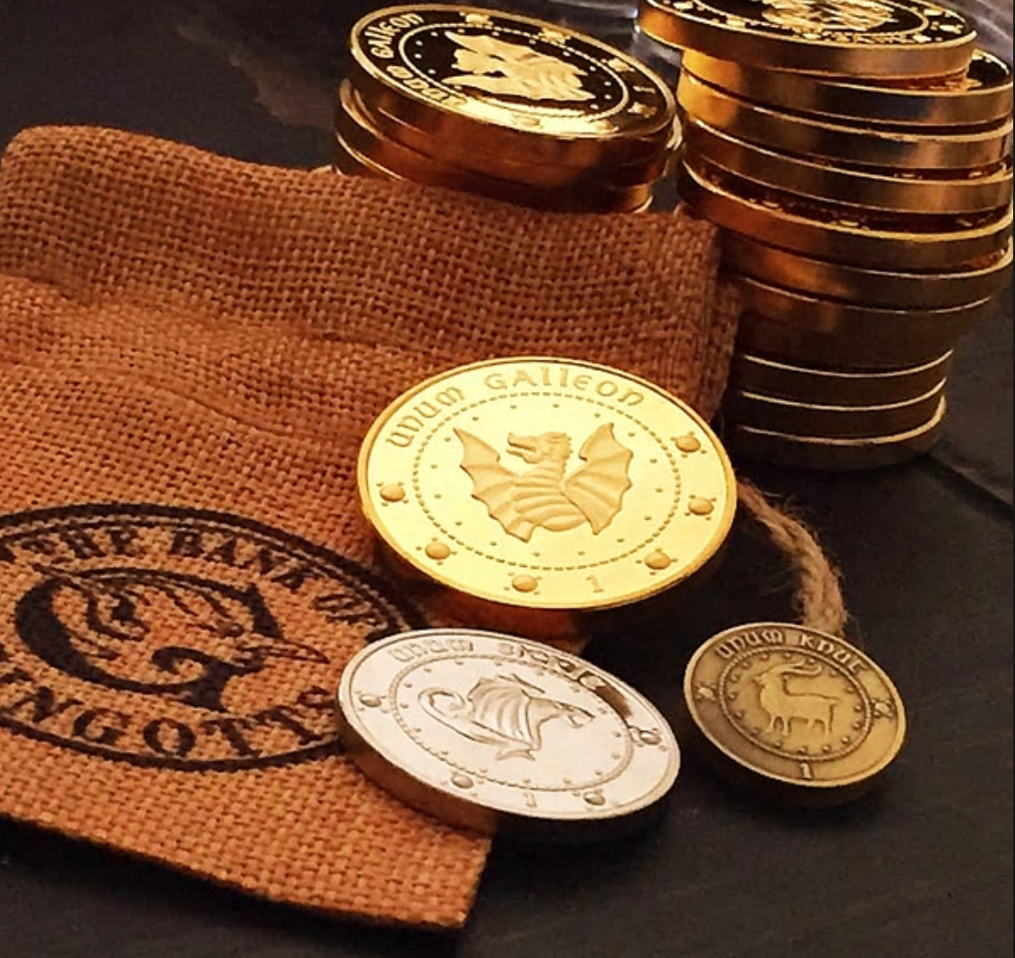
Let’s Start With a Question
In an unpublished Harry Potter manuscript*, Ron Weasley wins a bag of 1 million golden Galleons. He is given a choice by the Gringotts goblin banker when he deposits his winnings. Ron can choose to deposit his 1 million Galleons and pay a 20% handling fee to Gringotts Bank or he can pay his handling fee as two payments of 10%. What should Ron do? He is unable to send an OWL to Hermione or Harry.
* May not reflect the true nature of the existence of an unpublished Harry Potter manuscript.

Slide 4
24
7
30
Title: Percentages
Date: 28/08/2018
EQ – How do we find the value of items that are increased or decreased by percentage several times?
Consider the following situation:
Ando Funtano is in his favourite surf shop because they are having an end of year sale with everything at 35% off. Surfboards have an additional 13% off if the board is over $500. How much is a $729.00 surfboard and a $40 pair of thongs going to cost Ando during this sale?
What are the steps to solve multiple percentage problems?
5

Slide 5
24
7
30
Title: Percentages
Date: 28/08/2018
EQ – How do we find the value of items that are increased or decreased by percentage several times?
Step 1: Find 35% of the surfboard and thongs (this is your savings from the sale)
Thongs Surfboard
0.35 X 40 = $14 0.35 X 729 = $255.15
Step 2: Subtract the discount from the original price. (this will find the new price of items)
Thongs: $40 – $14 = $26 Surfboard: $729 – $255.15 = $473.85
What are the steps to solve multiple percentage problems?
Step 3: Find 13% of the new surfboard price $473.85
0.13 X 473.85= $61.60
Step 4: Subtract the discount from the surfboard price to find the final price.
$473.85 – $61.60 = $412.25
Step 5: Add the new thong price and surfboard prices together
$26 + $412.25 = $438.25 (This is a saving of $769 – $438.25 = $330.75)
5

Slide 6
Jenny is buying shoes at the Rockingham shopping centre. The shoes that she is looking at cost $163. If Jenny buys two pairs of the same shoe the store will give her 15% off both pairs. If jenny buys three pairs of the same shoe the store will give 15% off each pair plus an additional 8% off each pair. How much will three pairs of shoes cost Jenny? What was her total saving?
Boxing bag cost $149. If I decrease the price by 17% then again by 24% what is the new price?
3. Craigo Daymango is an expert painter. His latest masterpiece costs $1220. A local buyer called Ridley Barr wants to buy the painting, however Craigo increases the painting price by 61% and later by another 7%. What is the cost of the painting?

